Slide 1
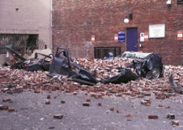
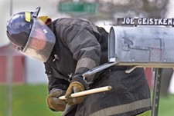
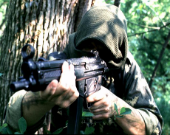
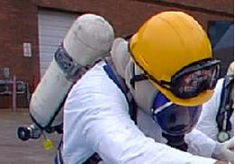
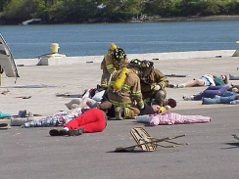
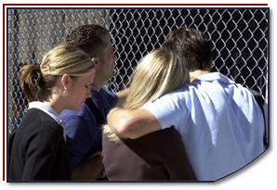
Disaster Site Worker Safety
C B R N E

Slide 2
Objectives
Identify chief characteristics of the five categories of potential terrorist threats.
Discuss Toxic Industrial Chemicals and the ability to acquire them.

Slide 3
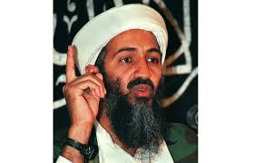
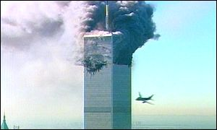
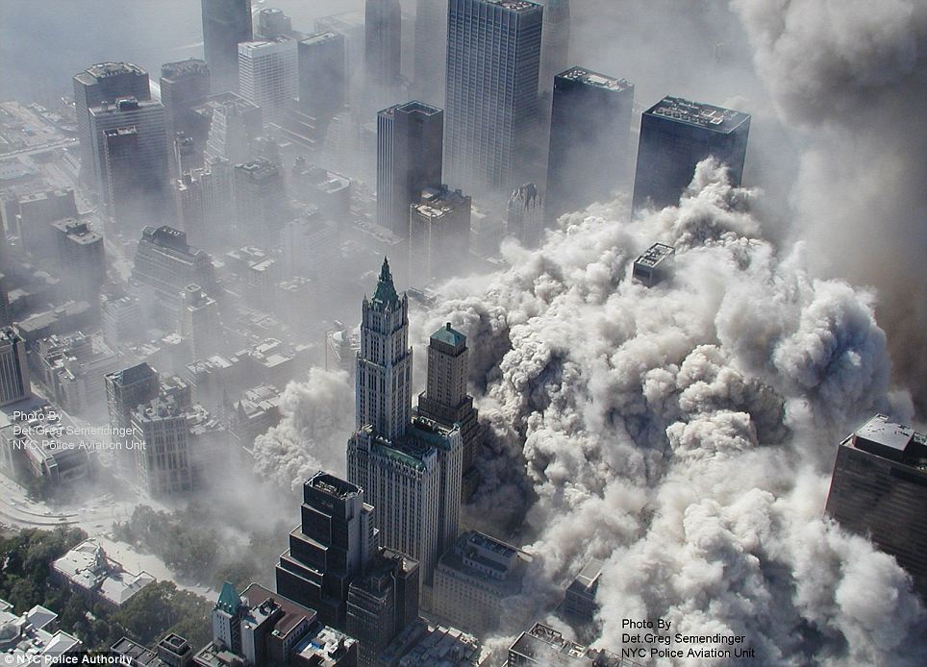
fact
They are motivated…
Have the opportunity…
They will go for it.
Military agents, as weapons of mass destruction, are available.
Industrial chemicals can be used as weapons.
Nothing is impossible for individuals to carry out terrorist activities if:

Slide 4

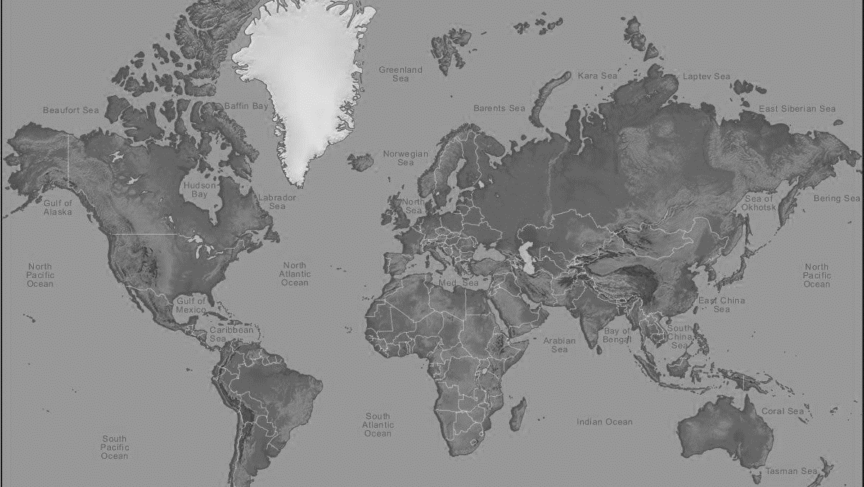

International Terrorist Threats
Global Terrorism Index 2016
Top 10 Countries
Iraq
Afghanistan
Nigeria
Pakistan
Syria
Yemen
Somalia
India
Egypt
Lybia
Top 5 countries accounted for 72% of all Terrorist fatalities in 2015!

Slide 5
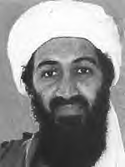


International Terrorist Organizations
Currently pose the greatest threat:
HAMAS
TALIBAN

Slide 6
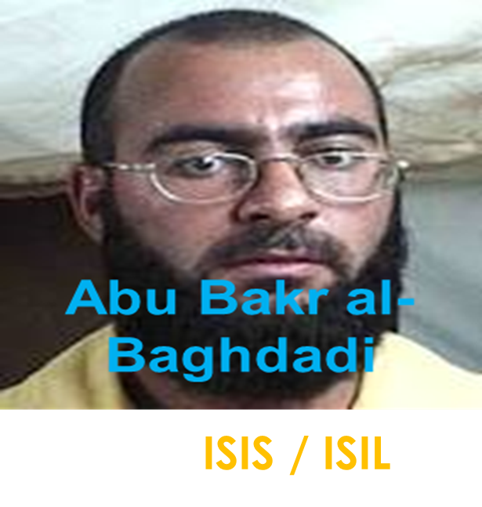

International Terrorist Organizations
Currently pose the greatest threat:
HIZBOLLAH

Slide 7
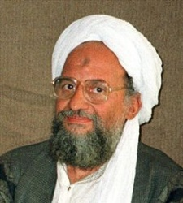
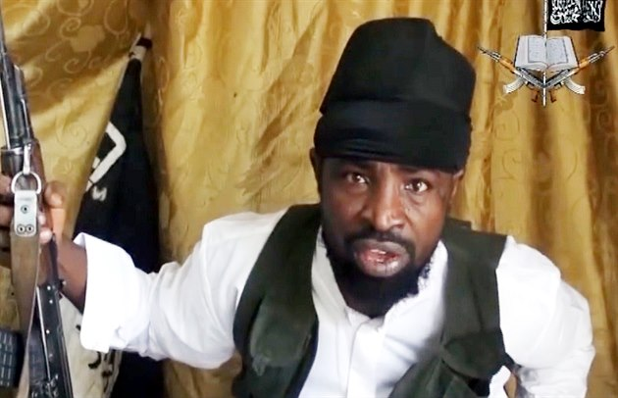
International Terrorist Organizations
Ayman Mohammed Rabie al-Zawahiri
Currently pose the greatest threat:
Abubakar Shekau
Al-Qaida
Boko Haram

Slide 8
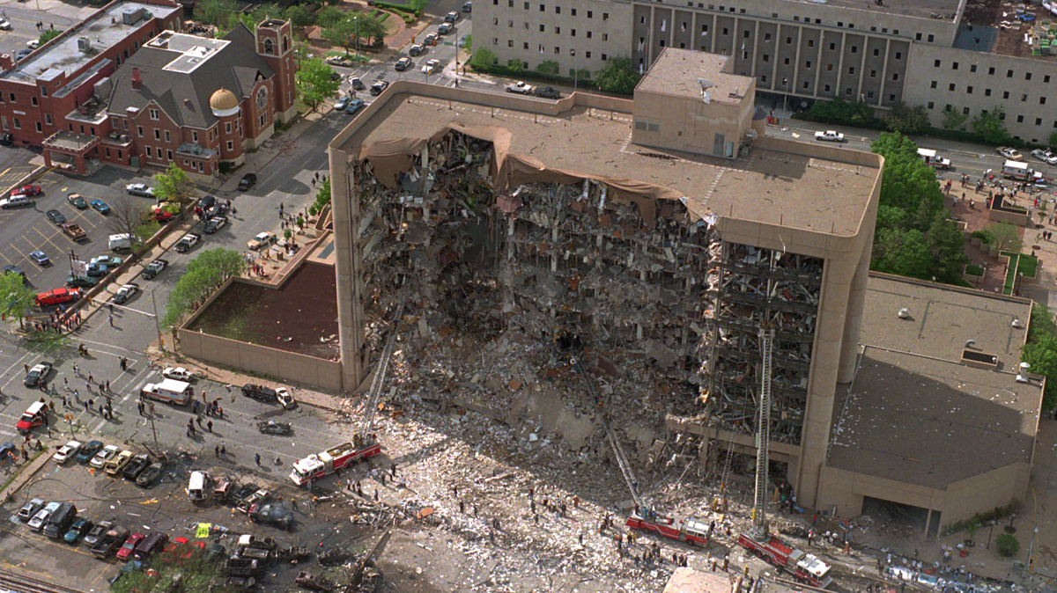
Domestic Terrorist Threat
Hate groups
Patriot groups
Religious groups
Cult groups
Single issue groups
Lone individuals
Oklahoma City – Alfred P. Murrah Building – April 19th, 1995 – 168 fatalities.

Slide 9
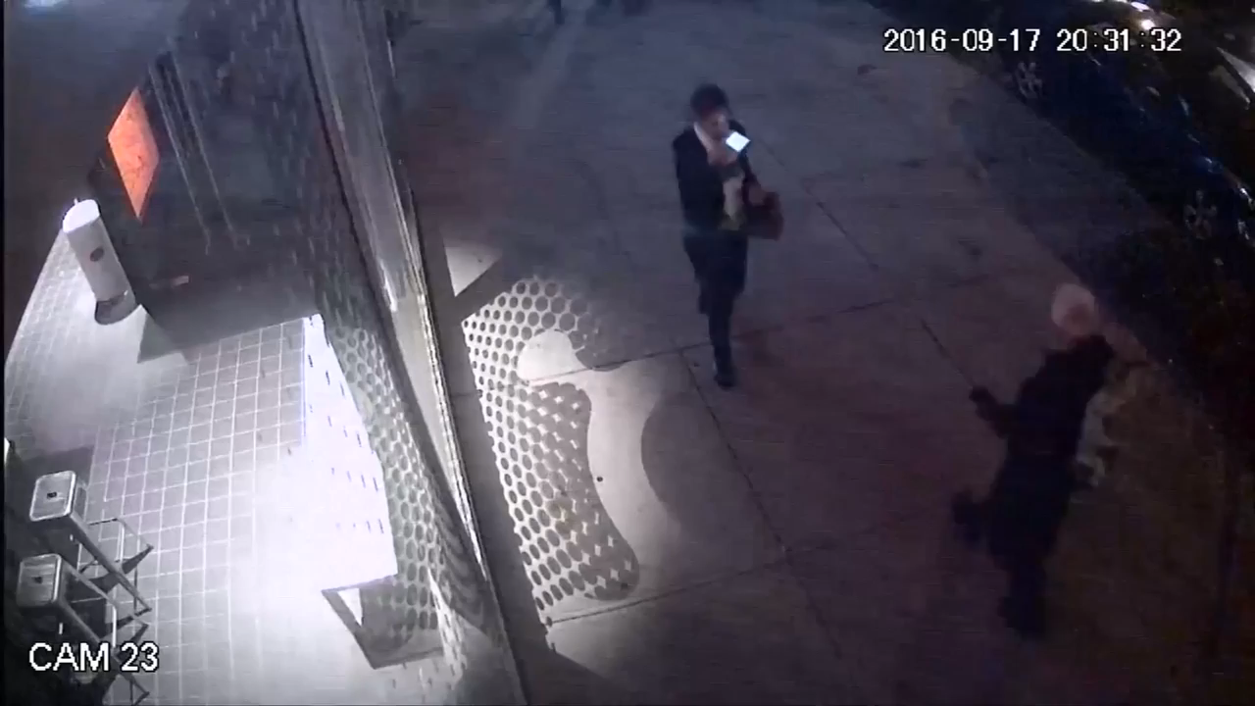

Slide 10

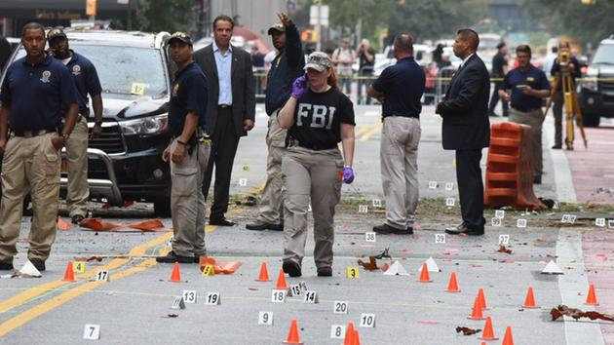
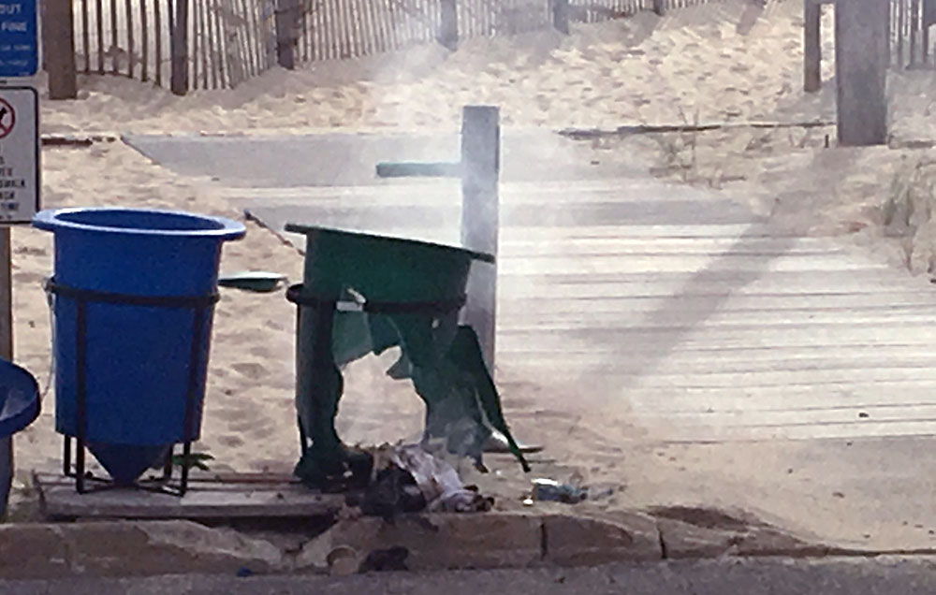
Domestic Terrorist Threat
Amhad Khan Rahimi
Targets including US Marine Veterans and civilians in multiple locations:
Seaside Park, NJ
Chelsea (NY City), NY

Slide 11
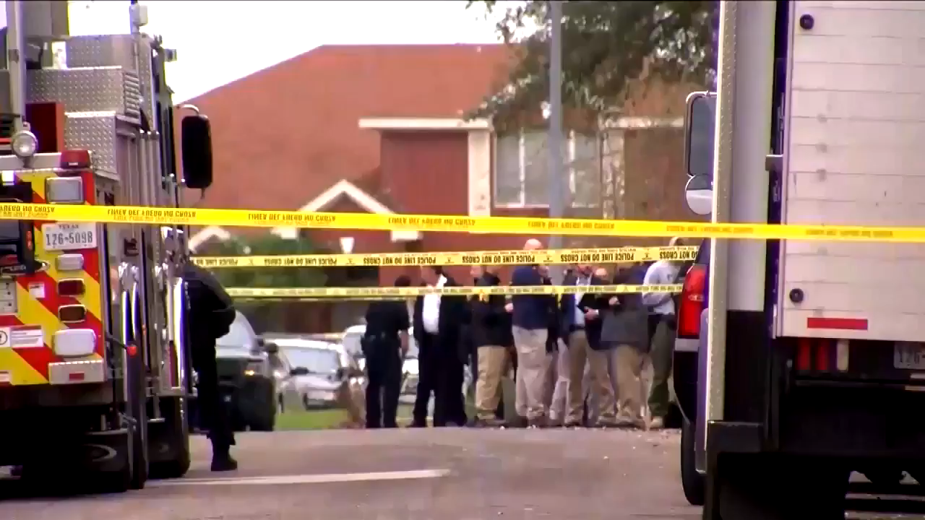

Slide 12



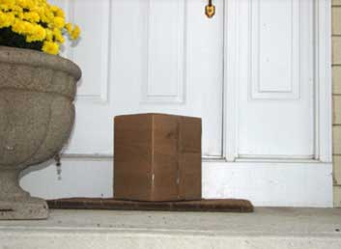
Domestic Terrorist Threat
Bomber
Austin, Texas
Under Investigation
Fear to open packages are the same as the fear imposed during the 2001 Anthrax attacks.
Mark Anthony Conditt

Slide 13
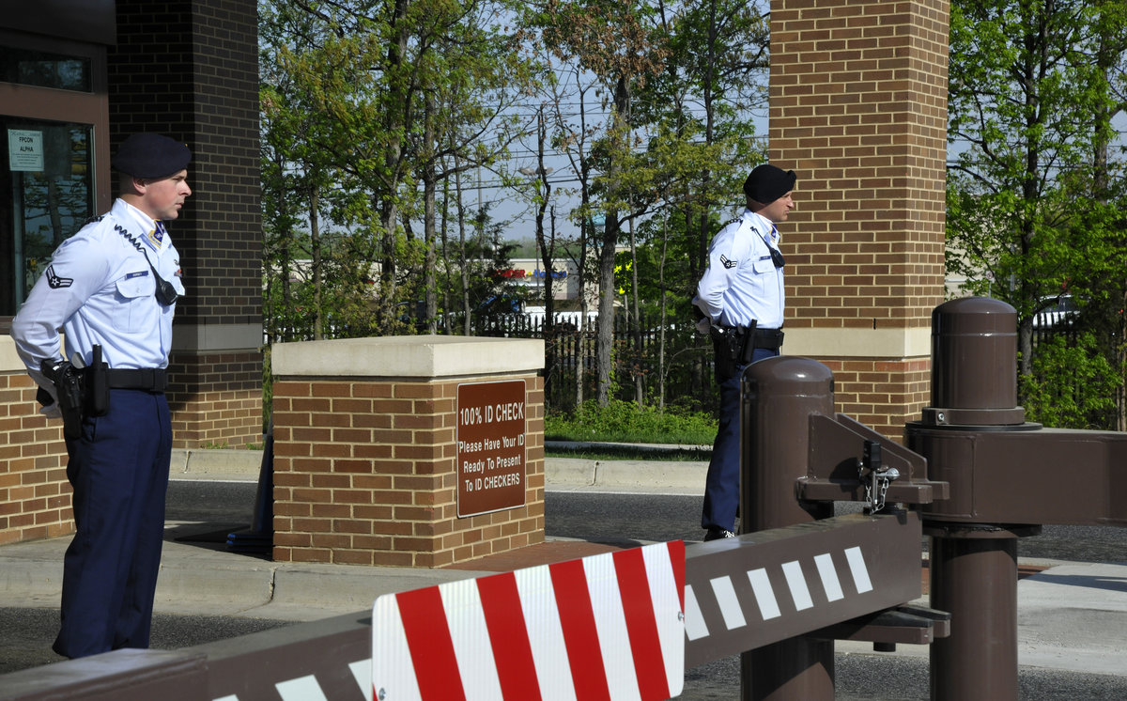
Industrial and Military Agents
Utilization of chemical and biological agents to cause death and destruction:
  Cheap
  Relatively easy to obtain
  Effective
  Hard to detect
  Explosive
QUESTION
How hard is it to obtain the items you need to cause death & destruction?
Where would you go to get the items you need?

Slide 14


ANSWERS
How hard is it to obtain the items you need to cause death & destruction?
EASY
2. Where would you go to get the items you need?
HERE

Slide 15
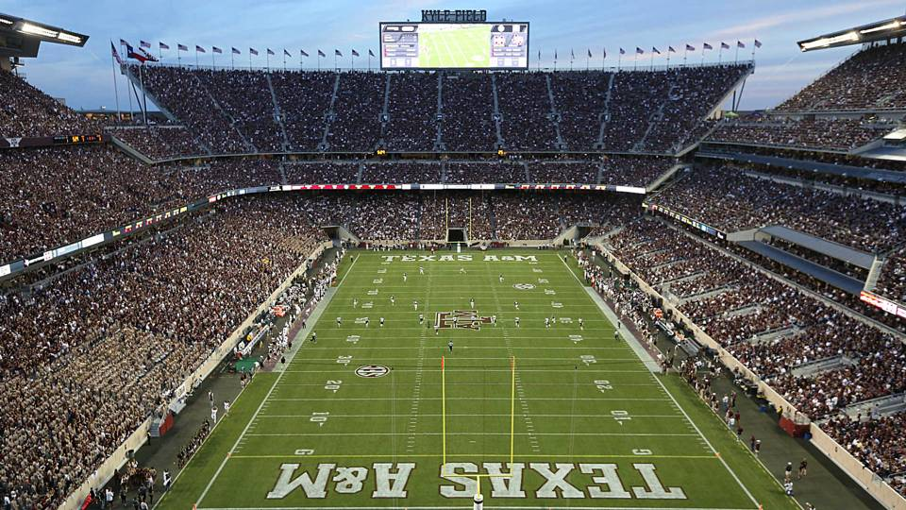
Potential Targets
Ideal targets are indoors
  Large crowds
    Ensure more casualties/fatalities
    Panic
    Media attention
  High profile events
    Instant media coverage
    Recognition of the Individual, group, or organization
Seating capacity: 102,733

Slide 16
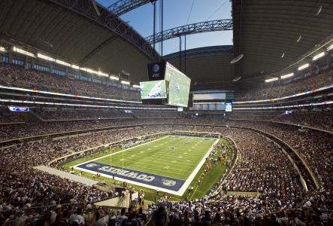
Potential Targets
Ideal targets are indoors:
  Large crowds
    Ensure more casualties/fatalities
    Panic
    Media attention
  High profile events
    Instant media coverage
    Recognition of the Individual, group, or organization
AT&T Stadium, formerly Cowboys Stadium
Seating Capacity: 80,000

Slide 17
DISCUSSION
As a group, lets identify potential targets in our community:
Remember to use the items below to help identify the potential targets.
  Large crowds
    Ensure more casualties/fatalities
    Panic
    Media attention
  High profile events
    Instant media coverage
    Recognition of the Individual, group, or organization

Slide 18
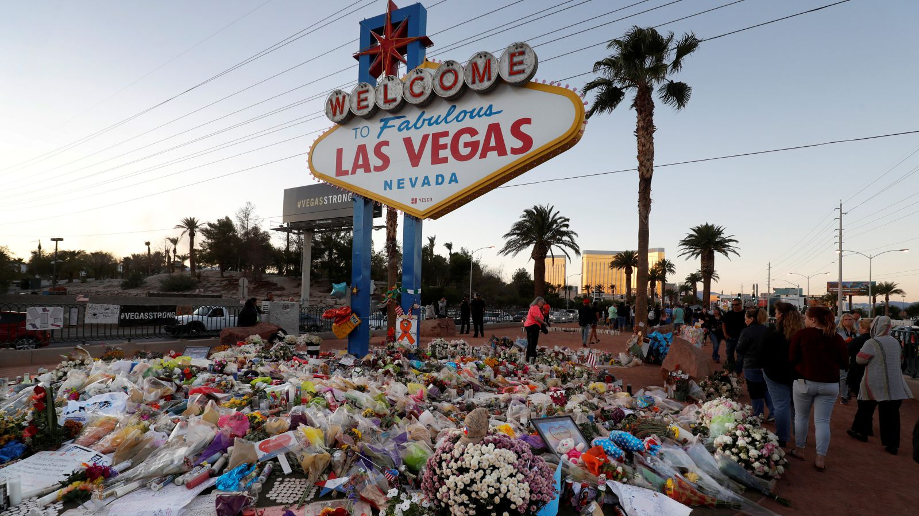
Threat Defined
Motive and ability
  Cause damage
  Inflict harm
  Kill
Additional hazards
  Armed resistance
  Booby traps
  Secondary events
59 Fatalities
851 Injuries
(422 by gunfire)

Slide 19

Categories of Terrorist Incidents
Chemical
Biological
Radiological
Nuclear
Energized or explosive
Acronym: CBRNE

Slide 20
Threat Is Real
Public assembly
Public buildings
Mass transit systems
Places with high economic impact
Electrical production and distribution
Telecommunications facilities
Places with historical or symbolic significance

Slide 21
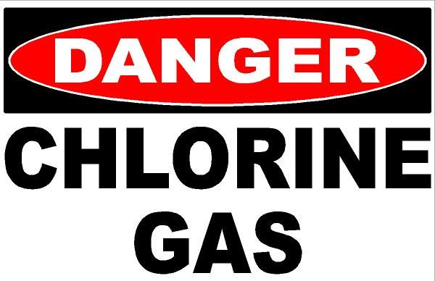
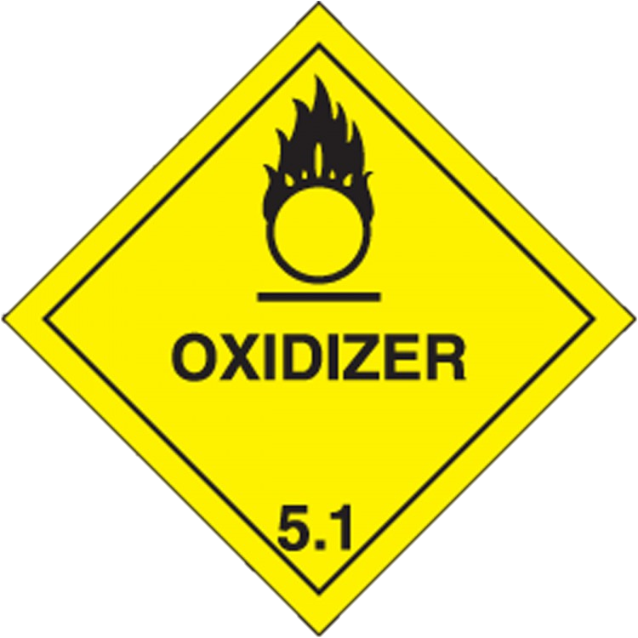
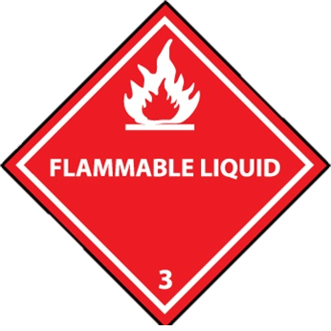
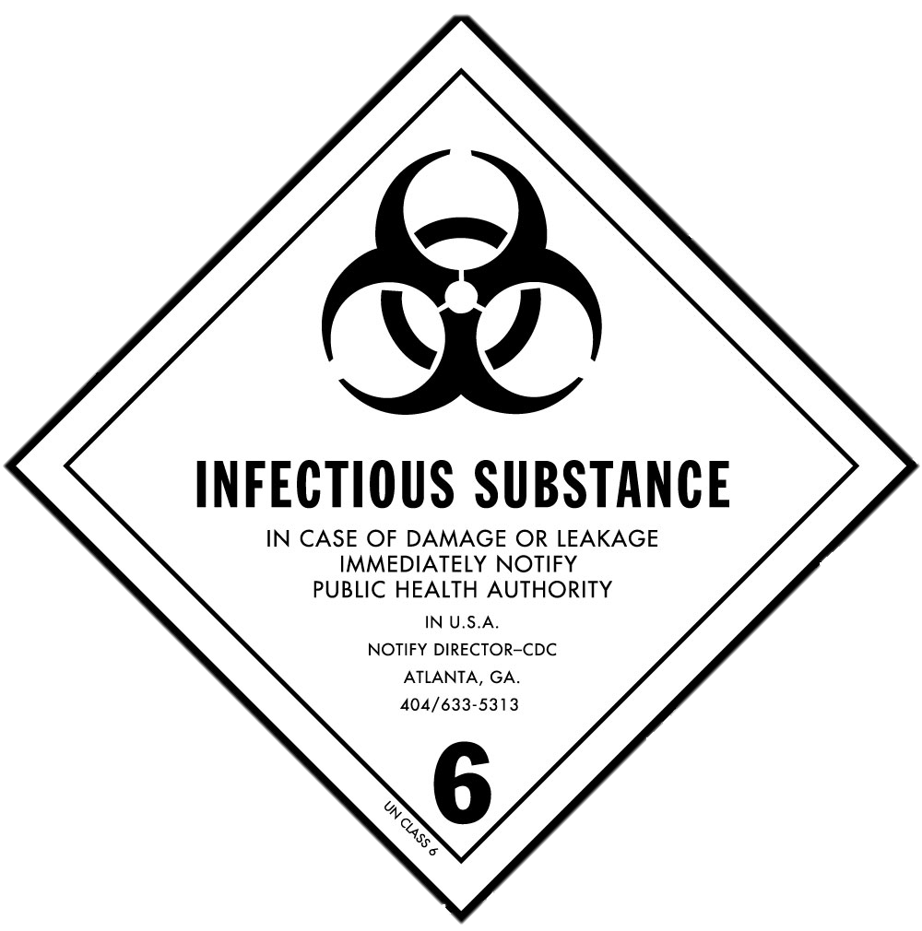
CHEMICALS
Toxic Industrial Chemicals TIC
Explosives
Flammable Gases
Flammable Liquids
Flammable Solid
Oxidizer/Organic Peroxides
Poisonous Materials/Infectious Substances
Corrosive Materials
Miscellaneous Hazardous

Slide 22
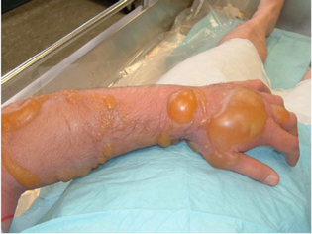
chemicals
Military Chemicals Agents
Nerve agents
Blister agents
Blood agents
Choking agents
Irritating agents
Blisters from Sulfur-Mustard
The next video shows a nerve attack in Syria.
VIEWER DISCRETION ADVISED

Slide 23


Slide 24
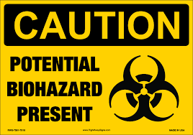
BIOLOGICALS
Biological Agents
Biohazards
Hepatitis C
  1 in 30 “Baby Boomers may have the virus”
Hepatitis B
  Vaccinations are available
HIV
Tuberculosis

Slide 25
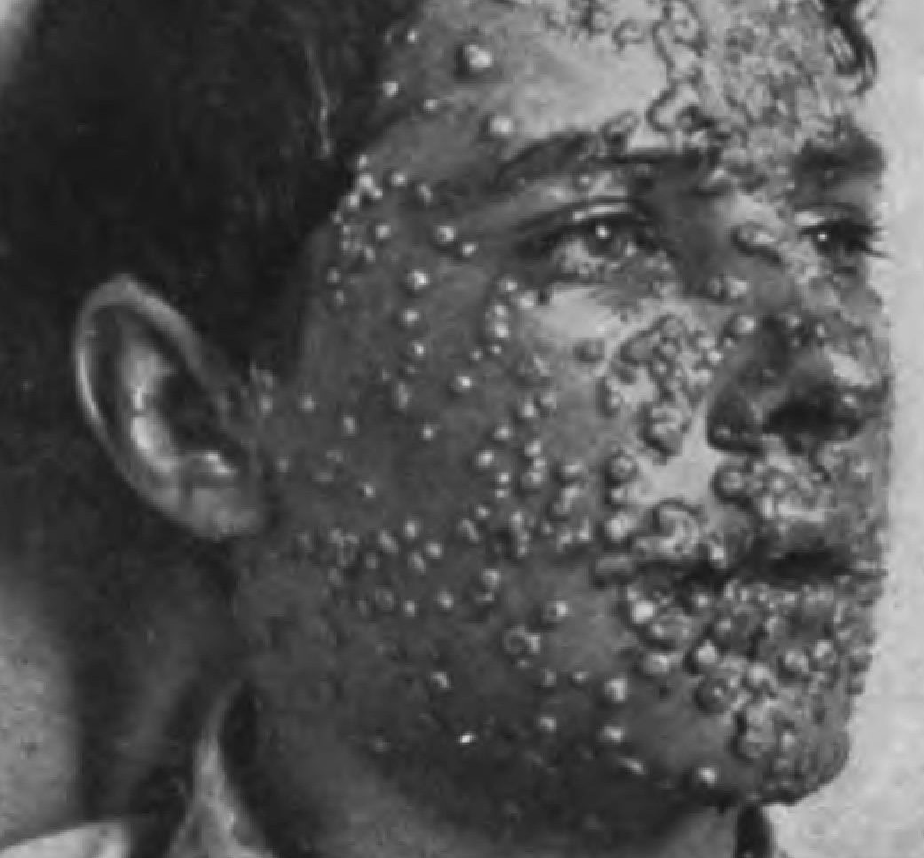
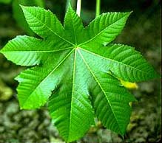
BIOLOGICALS
Biological Agents
The four common types of biological agents:
Bacteria
Viruses
Rickettsia
Toxins
Smallpox has a 30% mortality rate.
The toxin, ricin, from the Castor bean plant

Slide 26
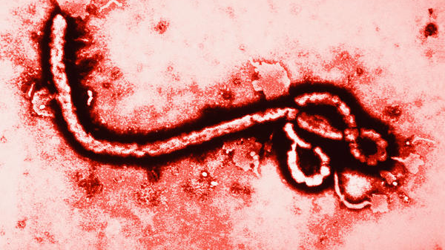

BIOLOGICALS
Biological Agents
Used as terrorist weapons
Anthrax
Tularemia
Cholera
Encephalitis
Plague
Botulism

Slide 27

CBRNE Overview
Radiological & Nuclear
The radiological incident could include the detonation, or threatened detonation, of a conventional explosive incorporating nuclear material (radiological dispersal devices or RDD).
The nuclear incident is the use, threatened use, or threatened detonation of a nuclear bomb to create a scenario for a nuclear event.

Slide 28
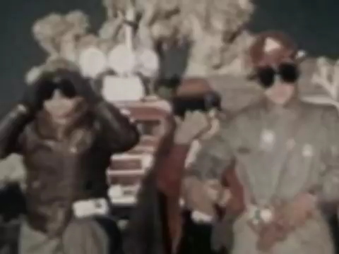

Slide 29
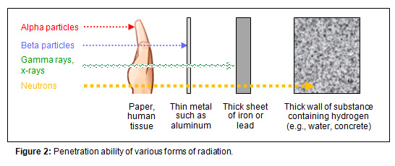
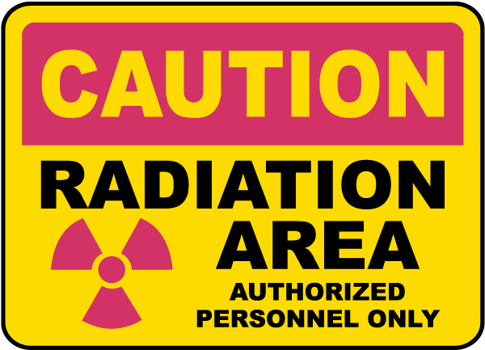
Ionizing Radiation
PARTICLES
Alpha
Beta
Gamma / X-rays
Neutrons

Slide 30
Energetic or
Explosives Devices (IEDs)
70% of all terrorist incidents involve explosives
Explosives can be used to disperse other CBRNE materials

Slide 31

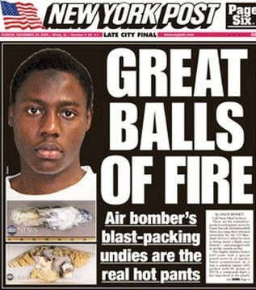
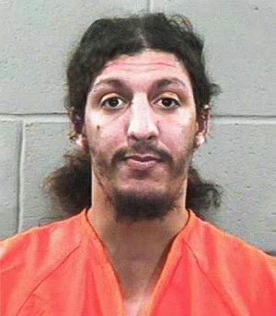
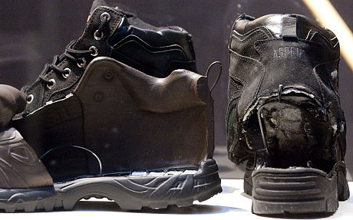
Energetic or
Explosives Devices (IEDs)
Umar Farouk Abdulmutallab
Nigerian
“Christmas Day”
“UNDERWEAR BOMBER”
QUESTION
Who are these “FAILED” attackers?
Richard Reid
Bromley, England
“SHOE BOMBER”

Slide 32

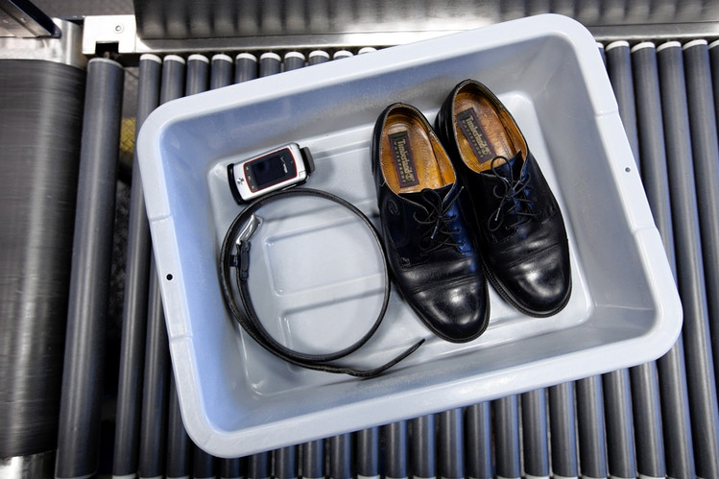
Energetic or
Explosives Devices (IEDs)
TSA
– BODY SCREENING -
QUESTION
How did their actions affect us?
TSA
– SHOES OFF –

Slide 33
activity
What are the FIVE Categories of potential terrorist threats?
Chemical
Biological
Radiological
Nuclear
Energized or explosive
Acronym: CBRNE

Slide 34

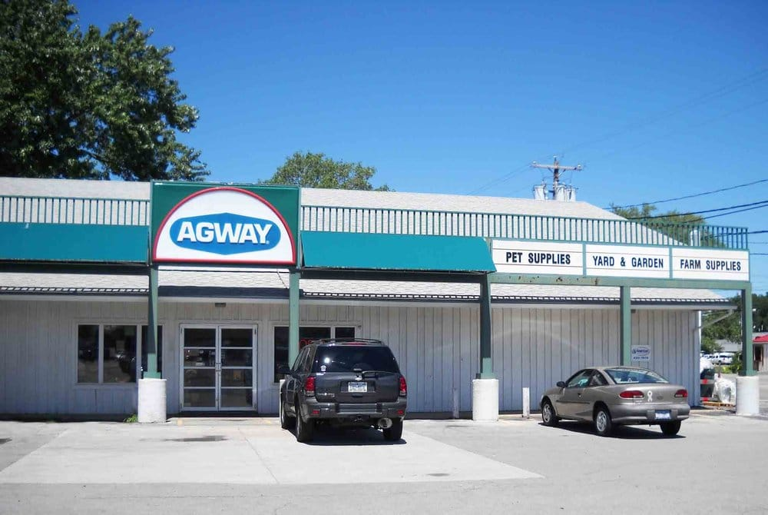

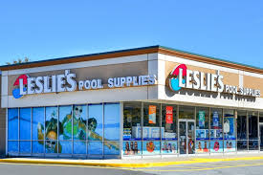


activity
What are TIC’s and provide an example of a place you may acquire them?
Toxic Industrial Chemicals

Slide 35
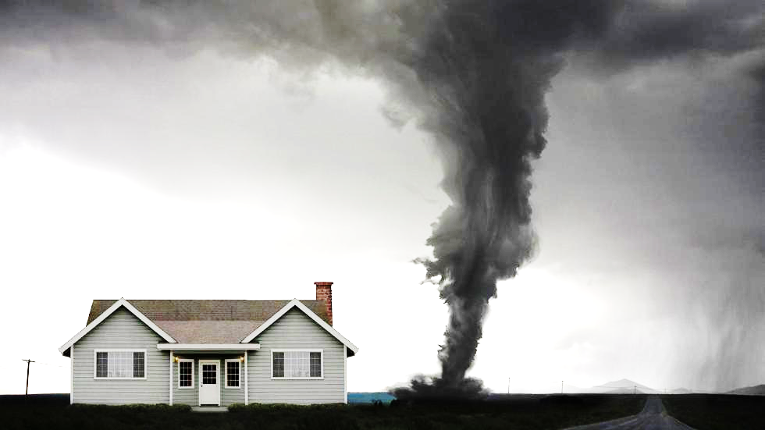
Dashboard
DISASTERS

